Slide 1

Performance Analysis of Classification Algorithms Using Different Data Set
Project Guide:
T Srikanth
Asst Professor
2451-15-733-136: T sai hemanth
2451-15-733-148: R rajashekhar
2451-15-733-149: G srihari
Department of Computer Science Engineering
M.V.S.R Engineering College

Slide 2
Contents slide no
Abstract
Problem Statement
Proposed Statement
Scope
Methodology
Datasets used
UML diagrams
Requirements
Result
Conclusion
Future work
References
3
4
5
6
7
16
22
25
26
31
32
33

Slide 3

Data Mining is a knowledge field that intersects domains from computer science and statistics, attempting to discover knowledge from databases in order to facilitate the decision making process. Classification is a Data Mining task that learns from a collection of cases in order to accurately predict the target class for new cases. Several machine learning techniques can be used to perform classification. In this report we will be discussing about four different types of classification techniques (Decision Tree Classification, K nearest Neighbor Classification, Naive Bayes Classification, Random Forest Classification) which will be applied to data sets . GUI developed analyses any dataset given to it by applying above techniques and builds a model for prediction for that particular dataset.

Slide 4
PROBLEM STATEMENT
• To identify for which type of dataset which classification technique is more suitable.
• There are three types of datasets (numerical, nominal and mixed) and many types of classification algorithms.
• Wrong selection of classification algorithm will certainly lead to bad classification model and bad results.
• It is also very hard to write each and every time code to analyze the dataset and create prediction model for it.
• So we designed a GUI which handles all these issues.
buying | v-high, high, med, low
maintenance | v-high, high, med, low
doors | 2, 3, 4,5
persons | 2,4,5
luggage boot | small, med, med
safety | low, med, high
This database may be particularly useful for testing constructive induction and structure discovery methods.

Slide 5

• The proposed performance analysis GUI is developed by using PYTHON and Tkinter package.
• We can upload datasets from our pc and check which algorithm is better for that dataset.Later we can create the prediction model for that dataset and apply it in real time.

Slide 6

• The scope of this project is to apply different type of datasets and come to a conclusion that for a particular type of dataset this algorithm is suitable
• It helps beginner to chose algorithm ,and we also want to decrease the work of a person by designing a GUI which analyses and creates a prediction model for any given dataset.

Slide 7

For classification of the different dataset we used 4 methodologies which are :
1 Decision Tree Classification
2 K nearest Neighbor Classification
3 Naive Bayes Classification
4 Random Forest Classification
We use Python for calculating the accuracies of each and every classification individually and then we will see which classification has the highest accuracy. These Classifications are applied on the data set and the performance is measured based on the accuracy.

Slide 8

It is the simplest and easy than other data mining techniques.
KNN is a non-parametric method used for classification and
regression. It is a type of instance-based learning or lazy learning.
This technique classifies new belongings based on similarity
measure .the value of k always assign positive integer number .In
this algorithm the training data are stored. Based on the neighbors or
nearest prediction of test data is complete.

Slide 9
Advantages:
KNN is pretty intuitive and simple.
Very easy to implement for multi-class problem
Can be used both for Classification and Regression
Disadvantages:
KNN is computationally expensive.
Variables should be normalized, or else higher range variables can bias the algorithm.
Data still needs to be pre-processed.

Slide 10

Decision tree is a Supervised machine learning algorithm used to solve classification problems.
The main objective is the prediction of target class using decision rule taken from prior data. It uses nodes and internodes for the prediction and classification.
The typical algorithms of decision tree are ID3,CART.The main objective of using Decision Tree in this research work is the prediction of target class using decision rule taken from prior data.
It uses nodes and internodes for the prediction and classification. Root nodes classify the instances with different features.

Slide 11
Advantages:
• A major decision tree analysis advantages is its ability to
assign specific values to problem.
• The decision tree model is transparent in nature.
• It allows for a comprehensive analysis of the consequences
of each possible decision.
Disadvantages:
May suffer from over fitting.
Classifies by rectangular partitioning.
Does not easily handle nonnumeric data.
Can be quite large- pruning is necessary.

Slide 12

Naive Bayes is a classification technique with a notion which defines all features are independent and unrelates to each other.
It defines that status of a specific feature in a class does not affect
the status of another feature.
Naive Bayes classifiers assume attributes have independent distributions.
It is known as Naive because it relies on two important simplifying assumptions. The predictive attributes are conditionally independent and secondly it assumes that no hidden attributes bias the prediction process. It is very fast to train and fast to classify .

Slide 13
Advantages:
A Naive Bayesian model is easy to build and useful for massive datasets.
It is simple, and is known to out perform even highly sophisticated classification methods.
Good result obtained in most cases.
Disadvantages:
Assumes class conditional independence, therefore loss of accuracy.
• Practically, dependencies exist among variables.

Slide 14

Random forest is a Supervised machine learning algorithm used to solve classification problems. It is a method that operates by constructing multiple decision trees during the training phase. The decision of majority of the trees is taken as the final decision.

Slide 15
Advantages:
As we mentioned earlier a single decision tree tends to overfit the data. The process of averaging or combining the results of different decision trees helps to overcome the problem of overfitting.
Random forests also have less variance than a single decision tree. It means that it works correctly for a large range of data items than single decision trees.
It also maintains accuracy even when a large proportion of the data are missing.
Disadvantages:
The main disadvantage of Random forests is their complexity. They are much harder and time-consuming to construct than decision trees.
They also require more computational resources and are also less intuitive. When you have a large collection of decision trees it is hard to have an intuitive grasp of the relationship existing in the input data.

Slide 16

Dataset | No of attributes | No of Instances
PIDD | 8 | 768

Slide 17
PIDD Attributes
NO | NAME OFATTRIBUTES | TYPE
1 | Number of pregnant | Numeric
2 | Glucose | Numeric
3 | Blood Pressure(mm HG) | Numeric
4 | Skin Thickness | Numeric
5 | Insulin | Numeric
6 | Body Mass Index(BMI) | Numeric
7 | Diabetes Pedigree function | Numeric
8 | Age(years) | Numeric

Slide 18

NO | NAME OF ATTRIBUTES | TYPE
1 | Buying | Nominal
2 | Maintenance | Nominal
3 | Doors | Nominal
4 | Persons | Nominal
5 | Luggage Boot | Nominal
6 | Safety | Nominal
buying | v-high, high, med, low
maintenance | v-high, high, med, low
doors | 2, 3, 4,5
persons | 2,4,5
luggage boot | small, med, med
safety | low, med, high

Slide 19
CD MODEL EVALUATION
CAR | car acceptability
.PRICE | overall price
..buying | buying price
..maint | price of the maintenance
.TECH | Technical characteristics
..COMFORT | Comfort
...doors | number of doors
...persons | capacity in terms of persons to carry
...lugg boot | the size of the luggage boot
..safety | estimated safety of the car

Slide 20
GERMAN CREDIT DATASET
German credit dataset is originally from the kaggle website. The objective is to predict the purpose of the customer .
•Age : age (years)
•Sex: Gender (male or female)
•Job: number of jobs (1, 2 ,3 …)
•Housing: house details (own, rent, free ….).
•Saving account: status of saving account (little, moderate, quite rich …).
•Checking account: status of checking account (little, moderate).
•Duration: time.
•Credit amount: money
•Purpose (car, radio , business, tv ….)

Slide 21
GCD Attributes
NO | NAME OFATTRIBUTES | TYPE
1 | Age | Numeric
2 | Sex | Nominal
3 | Job | Numeric
4 | Housing | Nominal
5 | Saving account | Nominal
6 | Checking account | Nominal
7 | Credit amount | Numeric
8 | Duration | Numeric
9 | Purpose | Nominal

Slide 22

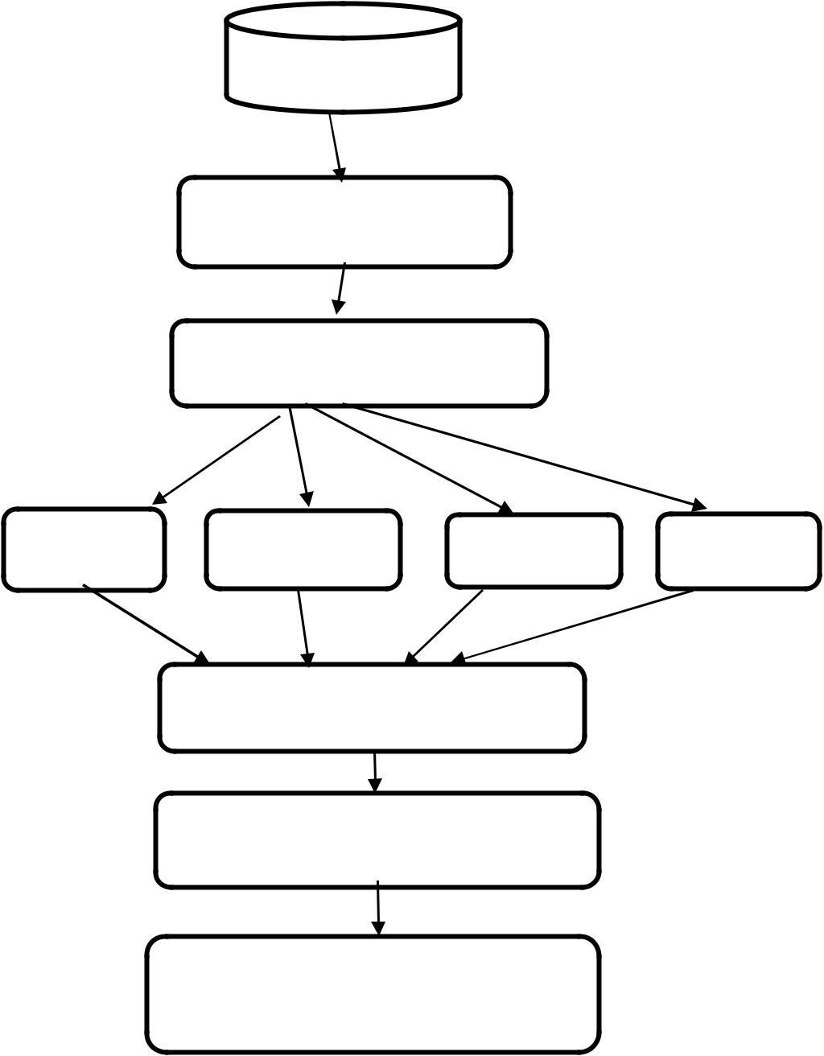
Data set
Data pre-processing
Classification algorithm
RF
KNN
NB
CART
Accuracy
Compare accuracy and deciding best algorithm
Prediction using best algorithm

Slide 23
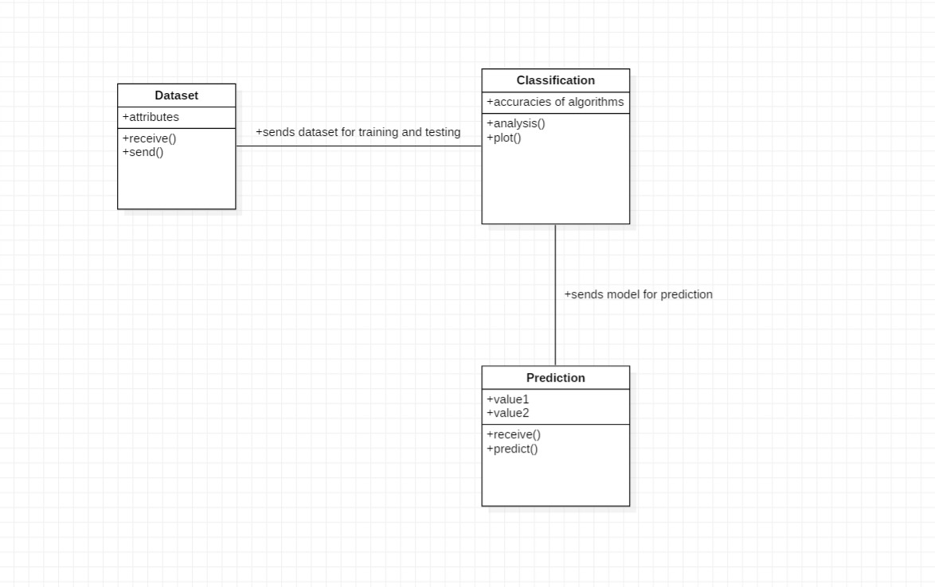
CLASS DIAGRAM

Slide 24
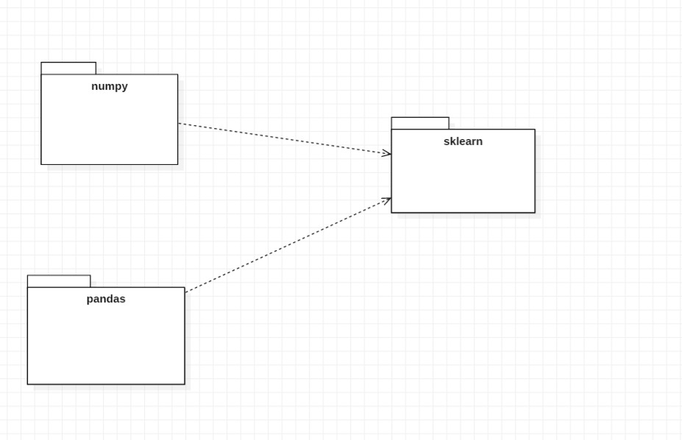
PACKAGE DIAGRAM

Slide 25
HARDWARE AND SOFTWARE REQUIREMENTS
•Hardware: Computer, Laptop.
•Software:
1.Operating system: All Operating Systems
2.Dataset: any Dataset.
3.Front end: Tkinter .
4.Back end: PYTHON.
Output can be viewed in Computers, Laptops.

Slide 26
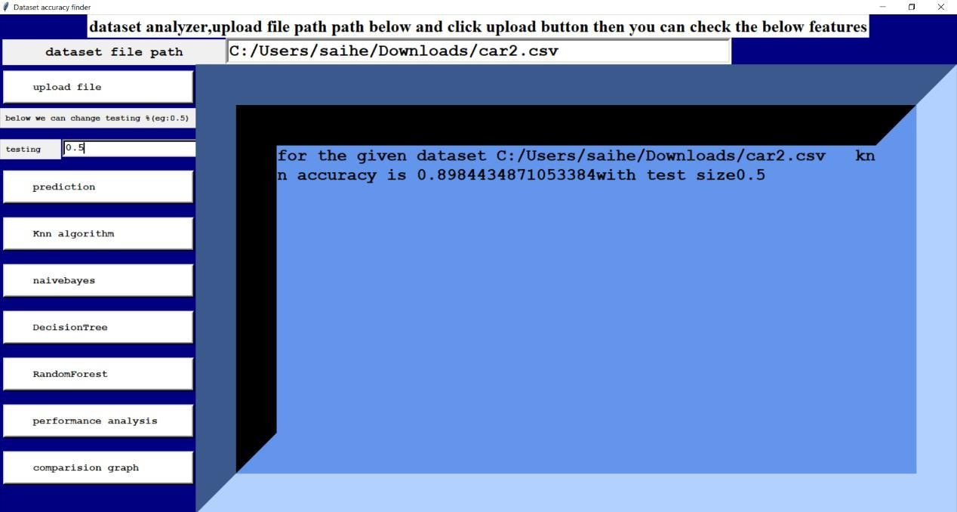
File uploading

Slide 27
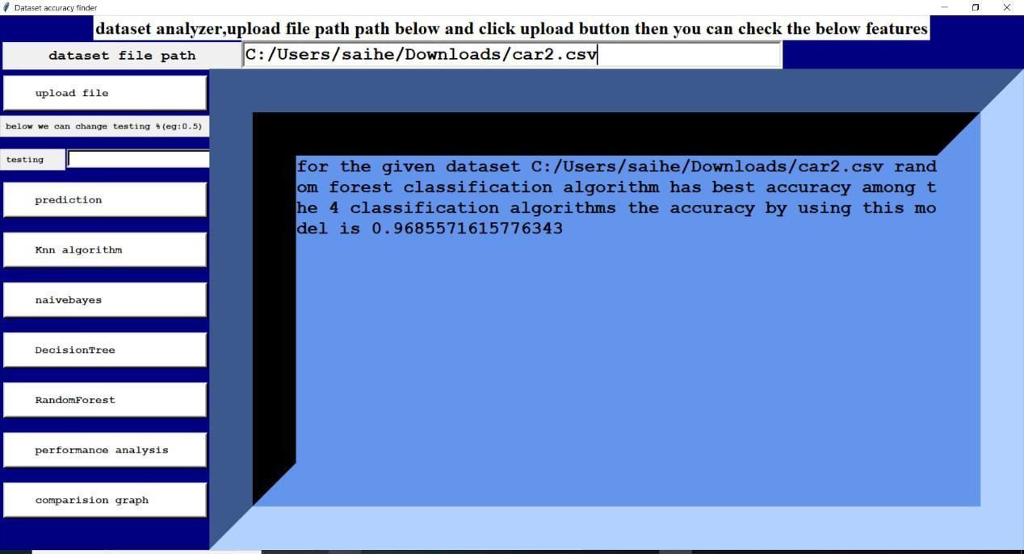
performance analysis

Slide 28
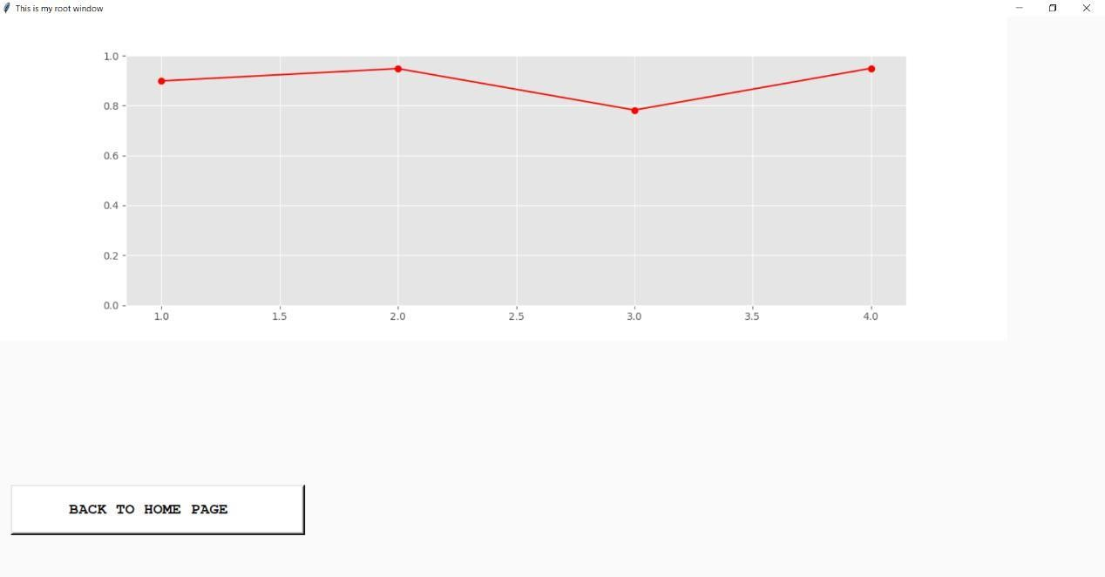
comparing accuracy graphs

Slide 29
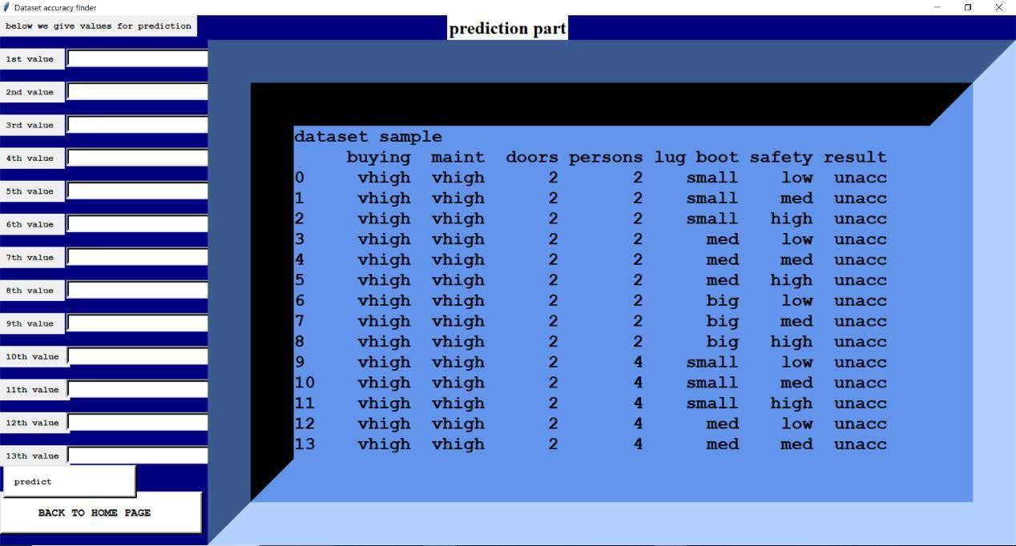
prediction part.

Slide 30
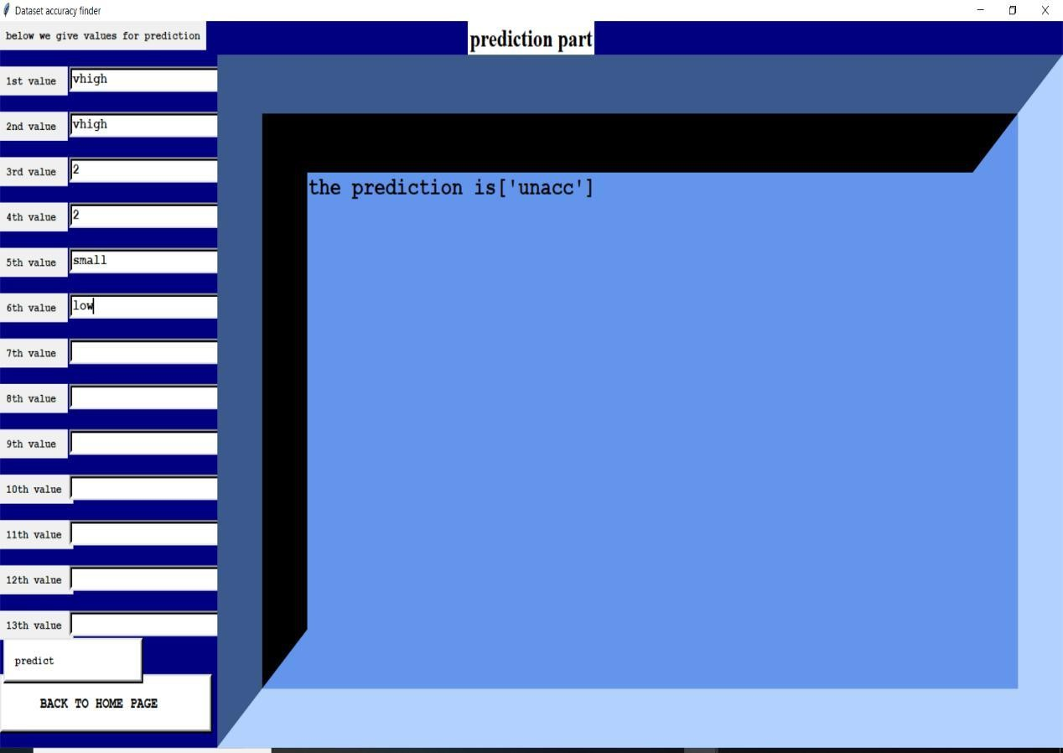
Result of prediction.

Slide 31
Conclusion after applying data
data | Huge dataset | Less dataset
numerical | Random forest | Random forest
nominal |  | Random forest
mixed | Naive bayes | Random forest

Slide 32
CONCLUSION AND FUTURE WORK
• The purpose of this study is to check the performance of different classification algorithms on different data sets. In order to achieve this, we have used three different data sets i.e., numeric data (diabetes data set), nominal data (car data set) and mix attribute data (German credit card data set).
• The results illustrate that the performance of Random forest classifier on numeric and nominal data set is superior to the other three techniques.
• The result also revealed that on mixed attribute data set, the decision tree classification technique and Random Forest almost have same accuracy and they outperformed the other two techniques.
• Therefore, this study simply revealed the important information that the different classification algorithms have different accuracy and performance on different kind of data sets.
• Our study certainly helps the beginners to choose the best classification algorithm in order to apply different kind of data set.

Slide 33

Our future work will consist of selection of some real world large data set and perform some suitable classification technique based on the nature and characteristics of the data and providing some important information out of the data set.

Slide 34
REFERENCES
• Shahrukh T, Prashasti K. A survey on decision tree based approaches in data mining. International Journal of Advanced Research in Computer Science and Software Engineering. 2015; 5(4):25–71.
• Vijayarani S, Muthulakshmi M. Comparative analysis of bayes and lazy classification algorithms. International Journal of Advanced Research in Computer and Communication Engineering. 2013; 2(8):3118–24.
• Durairaj M, Deepika R. Comparative analysis of classifi- cation algorithms for the prediction of leukemia cancer. International Journal of Advanced Research in Computer Science and Software Engineering. 2015; 5(8):787–91.
• Rupali B, Sonia V. Implementation of ID3 algorithm. International Journal of Advanced Research in Computer Science and Software Engineering. 2013; 3(6):845–51.

Slide 35


